Slide 1


Machine Learning approaches for Pressure Injury prediction
Muhammad Aurangzeb Ahmad^{1,2,*}, Barrett Larson^{3,4}, Steve Overman¹, Vikas Kumar¹, Jing Xie³, Alan Rossington³, Ankur Patel³ and Ankur Teredesai⁵
KenSci Inc
Department of Computer Science, University of Washington Bothell
Smith & Nephew
Stanford University School of Medicine
Department of Computer Science, University of Washington Tacoma
* Corresponding author: muhammad@kensci.com

Slide 2
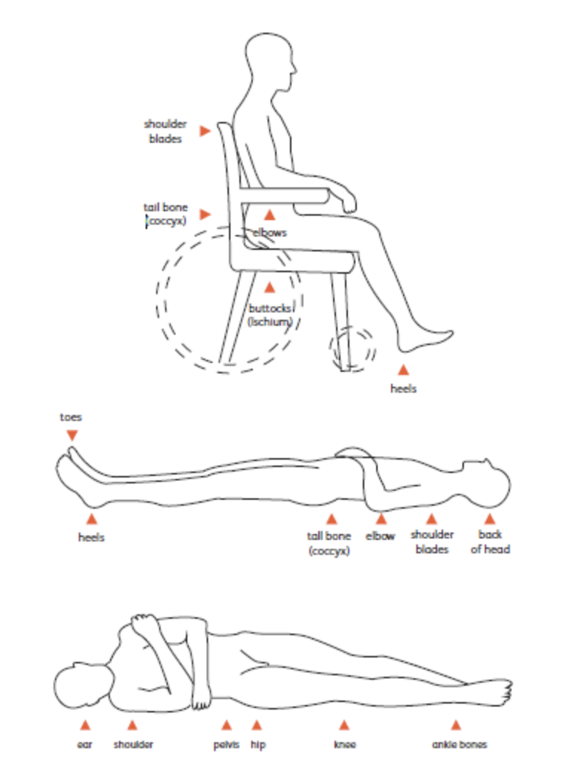
What is Pressure Injury?
Pressure injuries, also called bedsores or pressure sores, can develop when you are confined to a bed or chair
When you rarely move, your body weight restricts the blood flow to your arms, legs, neck, and back. The lack of blood flow to the skin and tissues under the skin may cause them to break down until a sore appears
People who use wheelchairs for much of the day or who must stay in bed for long stretches of time are at greatest risk for this type of injury
Notes:
Pressure injuries tend to surface on parts of the body where the skin is mashed between a bone and a surface such as a wheelchair or mattress
Pressure injuries can develop quickly, sometimes in as little as several hours without movement

Slide 3
Pressure Injury: Background
Official Definition
“Localized damage to the skin and underlying soft tissue, usually over a bony prominence or related to a medical or other device. The injury occurs as a result of intense and/or prolonged pressure, or pressure in combination with shear”
NPUAP [National Pressure Injury Advisory Panel]
Additional Background
Vary by clinical setting, and is a potentially preventable condition
Marker of poor overall prognosis
May contribute to premature mortality in some patients
Commonly seen in high-risk populations (elderly and very ill)

Slide 4
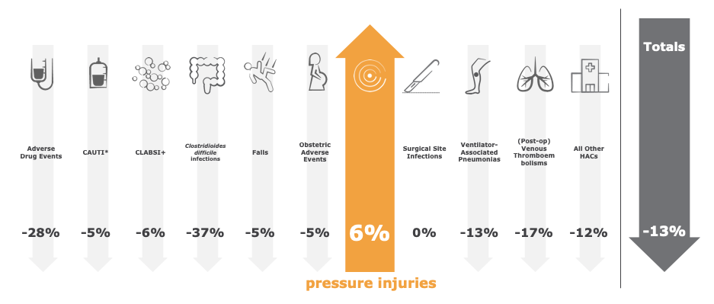

Why Pressure Injuries are a national health hazard?
Reference: National Scorecard on Hospital-Acquired Conditions, Agency for Healthcare Research and Quality (AHRQ). June 2019. Accessed November, 2019 AHRQ National Scorecard on Hospital-Acquired Conditions Updated Baseline Rates and Preliminary Results

Slide 5
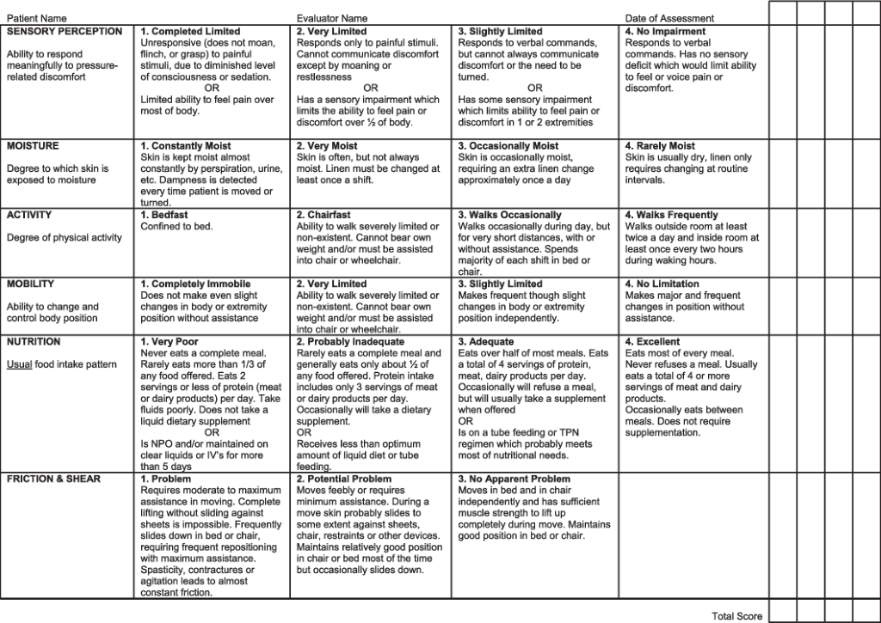
How is Pressure Injury Assessed?
Multiple risk assessment have been devised for pressure injury Norton Scale, Gosnell Scale, Shannon Scale, Waterlow Scale, Braden Scale, Cubbin & Jackson Scale etc.
Country specific scales also exist
The Norton Scale and Braden Scale are the most widely used scales
Several meta-analysis of Braden Scale has shown that it has moderate predictive power
Cubbin & Jackson Scale is often better for ICU patients as compared to Braden Scale

Slide 6
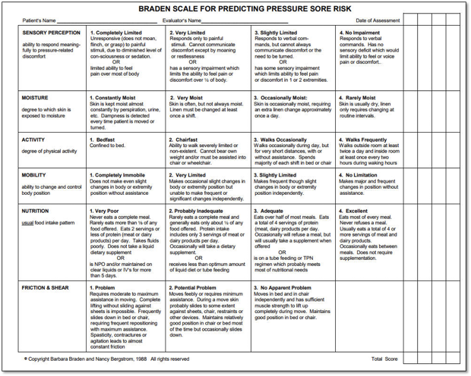
Braden Scale
Developed in 1980s as tool to facilitate a research study in nursing home patients
Never intended for hospitalized patients, surgical patients, ICU patients, etc.
Poor reliability, subjective in nature, high inter-rater variability
Visual assessment / requires eyes on patient

Slide 7
Related Literature: Risk Assessment
Braden Scale has moderate predictive validity and low predictive specificity for pressure ulcers in long-term care residents [Hyun 2013, Wei 2020]
Several meta-analysis of risk assessment scales, especially the Braden Scale, reveal that a new and modified scale is needed [Park 2016, Wei 2020]
“What is critical is not which scale is used but just that some validated scale is used in conjunction with a consideration of other risk factors not captured by the risk assessment tool” [Park 2016]
There have been several studies on using machine learning to predict pressure injuries and/or stages of pressure injury but they mostly focus on ICU data [Deng 2017, Jin 2017, Kaewprag2017, Alderden 2018, Levy 2020]
Notes:
Factor analysis of factors most predictive of pressure injury e.g., BMI, age, length of stay, mobility, friction/shear, norepinephrine infusion, peripheral vascular disease, pneumonia, cardiovascular disease etc. [Cox 2011, Su 2012, Cardiac 2016, Aloweni 2019, Pittman 2019, Cox 2020]
Several studies on using machine learning to predict pressure injuries and/or stages of pressure injury [Deng 2017, Jin 2017, Kaewprag2017, Alderden 2018, Levy 2020]
Automated pressure injury risk assessment system (Auto-PIRAS) that can assess pressure injury risk using data, without requiring nurses to collect or input additional data, and to evaluate the validity of this assessment tool [Jin 2017]

Slide 8
Evaluation of Braden Scale
Study | Length | Size | Setting | Braden cut-off | PPV (Precision) | Sensitivity (Recall) | Specificity | AUC
Hyun et al | 4 years | 7,790 | ICU | 16 | 0.11 | 0.95 | 0.21 | 0.67
Chen et al | Meta Analysis 8 studies | 41,489 | Long-term care | 12 to 16 | N/A | 0.80 | 0.42 | 0.76
Serrano et al | 2 months | 335 | ICU | 12 | 0.11 | 0.67 | 0.56 | 0.69
Wei el al | Meta Analysis 11 studies | 10,044 | ICU | 11 to 16 | N/A | 0.89 | 0.28 | 0.78
Jin et al | 1 year | 5,932 | University Hospital | 18 | 0.68 | 0.85 | 0.60 | 0.78
Note:
Most evaluation is done in an ICU setting
The mix of PI vs. non-PI is 15% to 50%

Slide 9


Dataset
US Federal Database
Multi-setting
In-patient
Out-patient
Nursing Home
Longitudinal Data
High Compliance
Large Scale
>40 Million Members per Year
>1 TeraByte in data files
400 Million Data Records
Highly Robust
Demonstrate Value
Diagnosis codes
Patient Information
Historical Claims
Current Claim

Slide 10
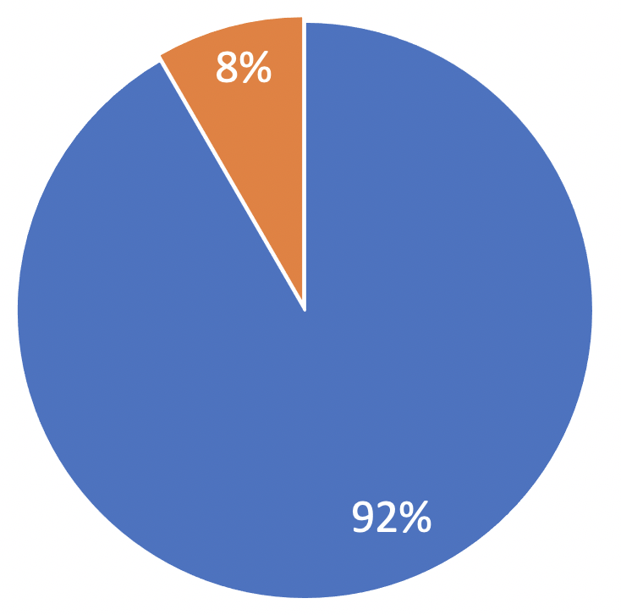
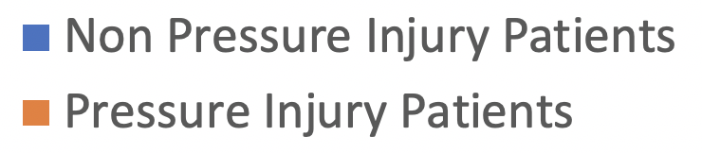
Data Summary
Total Patients Analyzed: 27.5M
PI Stage | Number of PI Patients
Stage 1 | 184K
Stage 2 | 418K
Stage 3 | 235K
Stage 4 | 228K
Unstageable | 207K
Unspecified | 216K
Other | 848K
Total | 2.2 million

Slide 11
Hospital Acquired Pressure Injury Cohort
Any diagnosis as PI
Number Claims: 656,904 (5.83%)
Number of Patients: 438,883 (6.63%)
HAPI
6.27% of PIs are POAs
0.36% are HAPIs
Overall Population
Number of Claims: 11,264,189
Number of Patients: 6,622,678
Present on Admission Diagnosis as PI
Number of Claims: 616,967 (5.48%)
Number of Patients: 415,566 (6.27%)
Admitting Diagnosis as PI
Number of Claims: 36,879 (0.38%)
Number of Patients: 31,624 (0.48%)

Slide 12
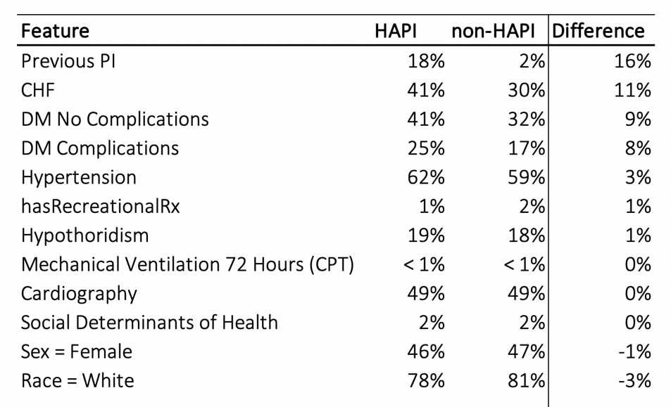
HAPI vs. non-HAPI Cohort

Slide 13
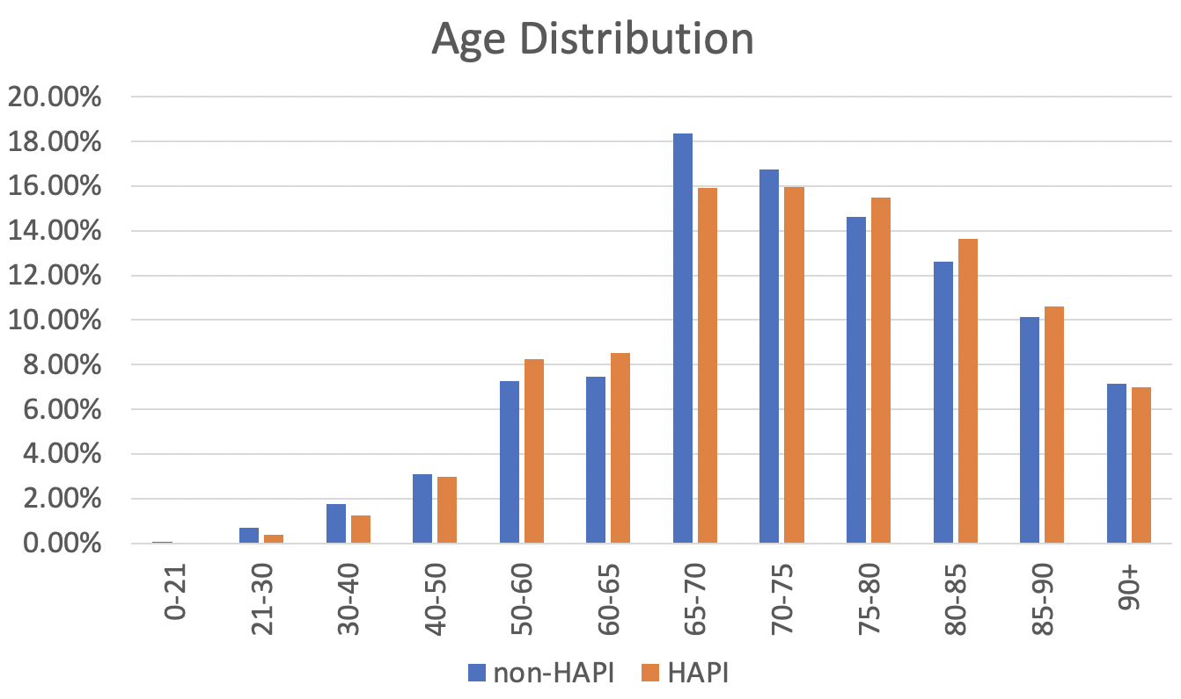
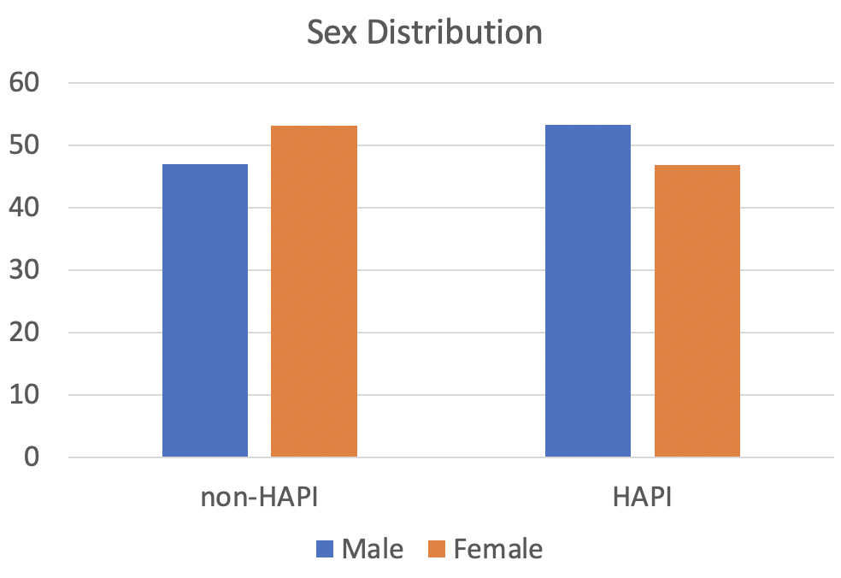
Demographic Characteristics
Skewed towards slightly older population
Greater prevalence in the male population

Slide 14

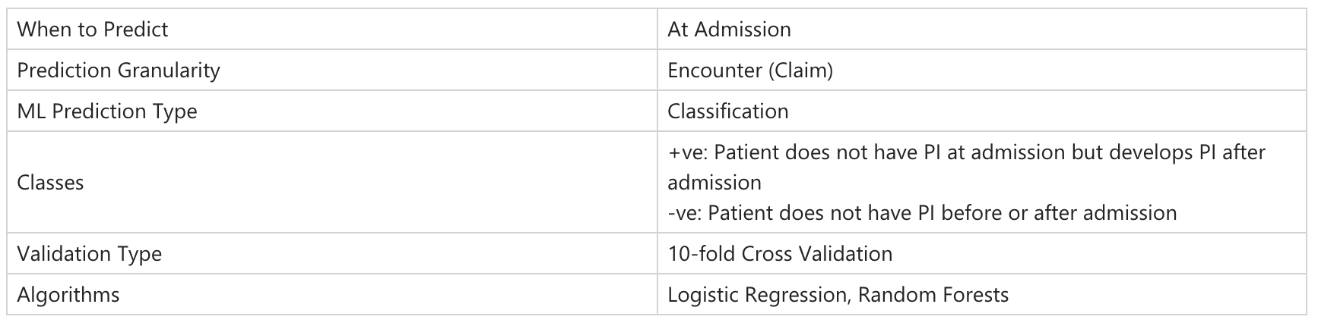
Model Set Up
Hospital Admission
PI Diagnosis
N Days
Patient History
Prediction Period
, XGBoost

Slide 15
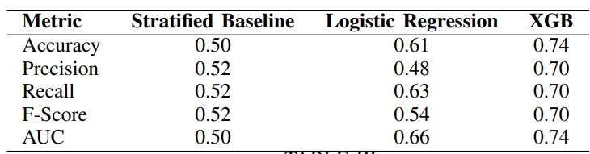
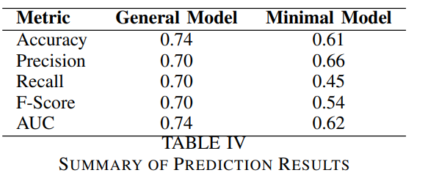
Model Performance

Slide 16
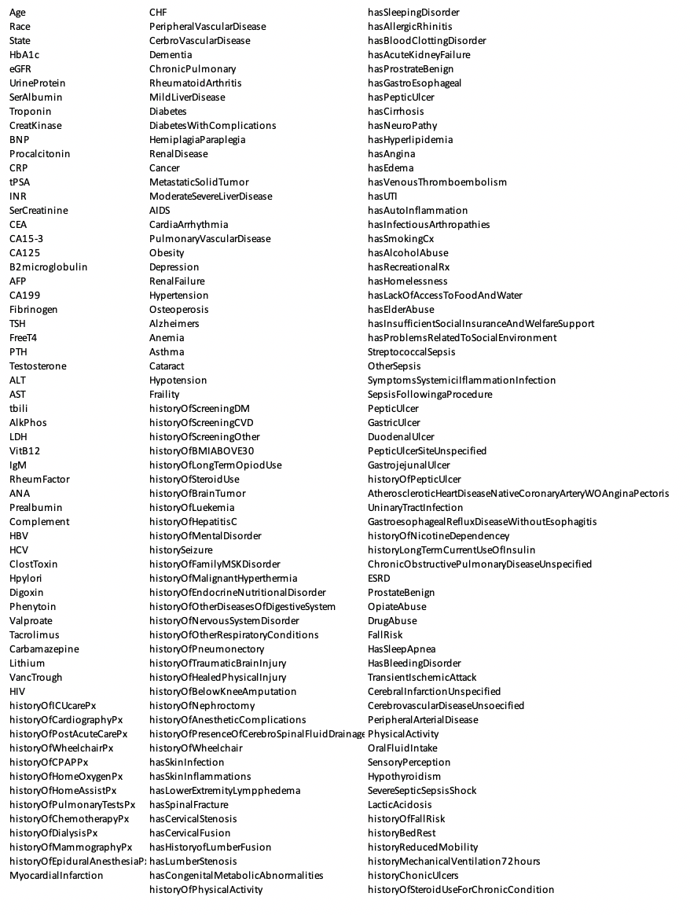
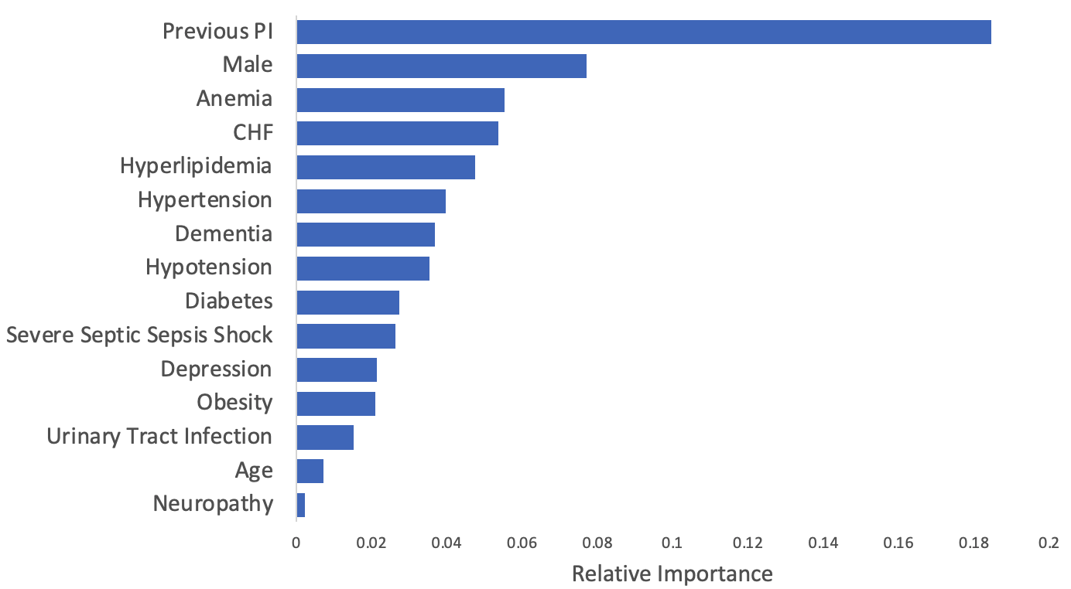
Key Features
List of Features Analyzed
Notes:
Discuss comparison with current approaches in the PI domain and healthcare AI in general

Slide 17


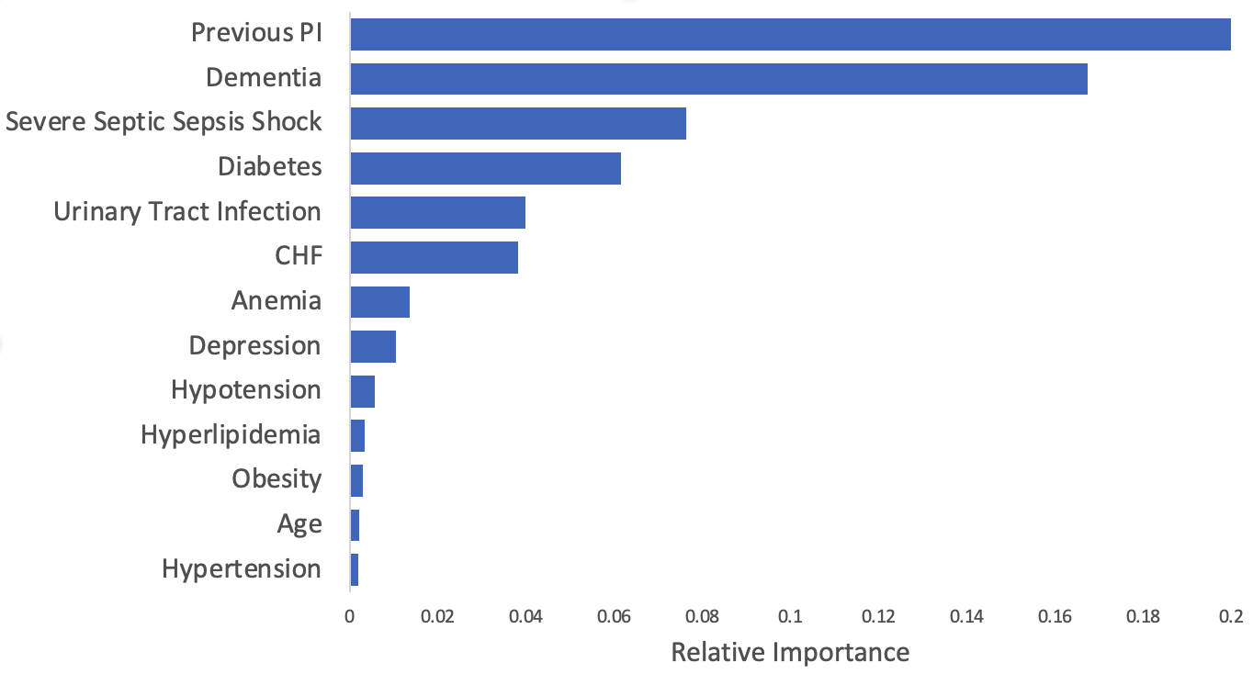
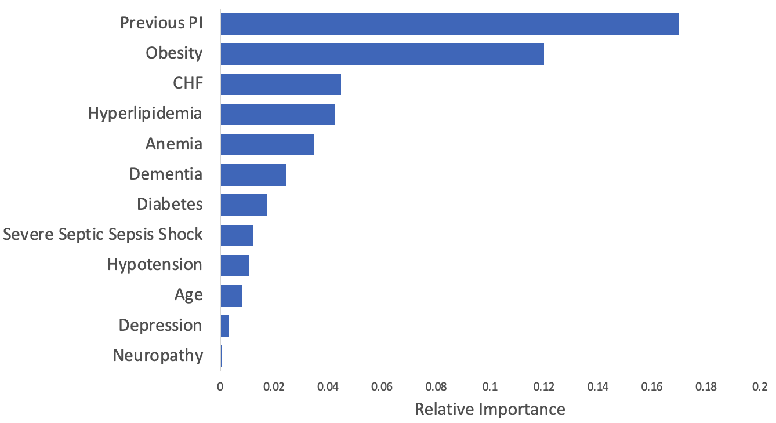
Prediction Models are Personalized
Risk Score = 75
Risk Score = 55

Slide 18




Next Steps: HAPI Prevention in the real world
Assess
Plan
Optimize
Automatically and reliably determine a patient’s evolving risk for developing a HAPI
Implement personalized, evidence-based prevention plans based on a patient's evolving risk
Use data to optimize resources and streamline workflows
Notes:
The assessment and the plan are ongoing and intertwined

Slide 19

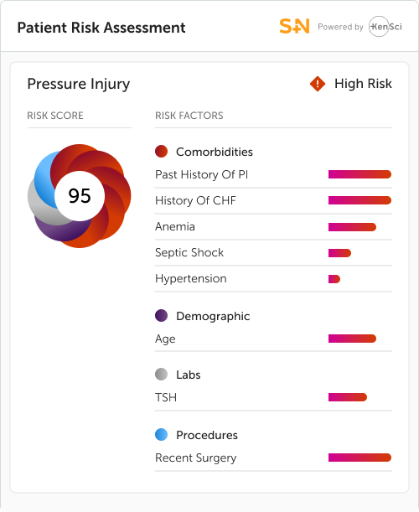
ASSESS PLAN OPTIMIZE
Ellen, Patient
HAPI Prevention
Ellen just came out of surgery. Due to her underlying risk factors, she is determined to be at high risk for a pressure injury.
The S+N risk prediction algorithm identified risk factors that would have been missed by traditional assessments.
Notes:
UI graphic overlay to represent ML insight (High risk of PI 95% alt metric score, provide legend for colors:,
Demographic (Age)
Labs (TSH)
Diagnosis/Comorbidities (History of CHF, Anemia, Past history of PI, Septic shock, hypertension)
Procedures (Recent surgery)

Slide 20


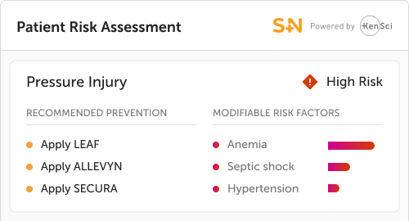
ASSESS PLAN OPTIMIZE
Sarah, RN
Personalizing the plan.
AI-driven insights help Sarah apply clinically-appropriate, evidence-based, and facility-recommended prevention strategies.
Given the high-risk, Sarah implemented a prevention strategy including LEAF, ALLEVYN, and SECURA.
Notes:
Based in the elevated risk a new plan is created
Show AI/ML model with Braden Scale?
Emphasize things which are not used in Braden Scale e.g., CHF, abnormal TSH
The Braden Scale sees that the patient has mobility, so it tags her as low risk but the AI/ML model tags her at high risk
Emphasize how the/why the current system does not work

Slide 21
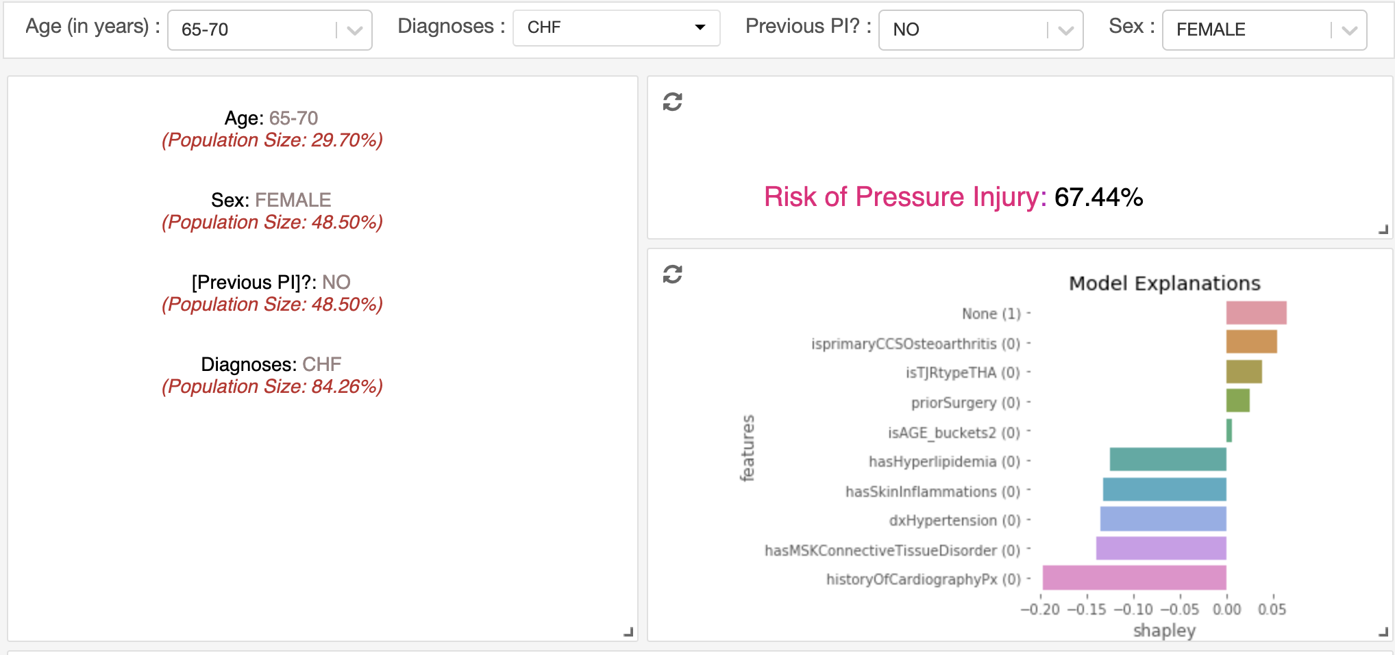
Conclusion: Future of HAPI Prevention
4
3
2
3
2
3
17

Slide 22
Conclusion: Future of HAPI Prevention
Traditional Methods
Generic
Subjective
Manual
Focused / Limited
High inter-rater variability
Relatively low accuracy
Static performance
Not adaptable
Machine Learning Based Methods
Personalized
Relatively Objective
Can be automated
Comprehensive / Can absorb more data inputs (incl. Braden)
Low inter-rater variability
Relatively high accuracy
Performance can improve over time (with more data)
Model can adapt to individual care settings (with local data)

Slide 23
Q&A
Muhammad Aurangzeb Ahmad*, Barrett Larson M.D, Steve Overman M.D, Vikas Kumar, Jing Xie, Alan Rossington, Ankur Patel and Ankur Teredesai
* Corresponding author: muhammad@kensci.com

Slide 24
Appendix

Slide 25
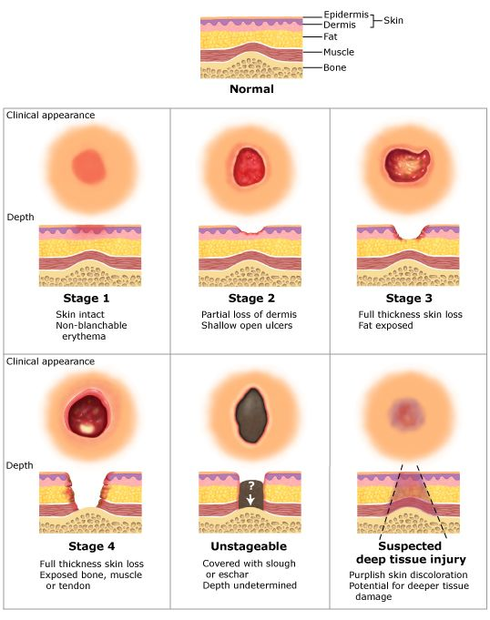
Stages of Pressure Injury
There are four stages of pressure injury
The staging system used for pressure ulcers was developed in the late 1980s by an NPUAP consensus conference and revised in February 2007
The stages range from mild reddening of the skin to severe tissue damage that can become infected, extending into muscle and bone
The staging system used for pressure ulcers was developed in the late 1980s by an NPUAP consensus conference and revised in February 2007

